Slide 1
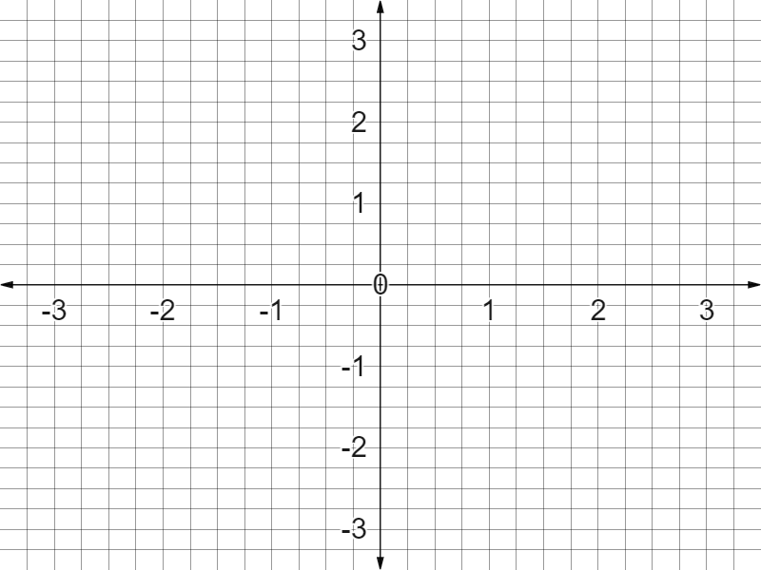

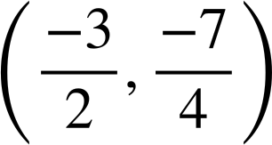
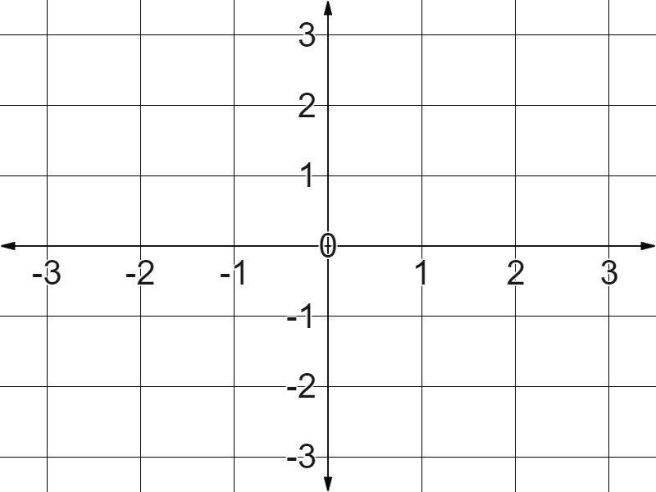
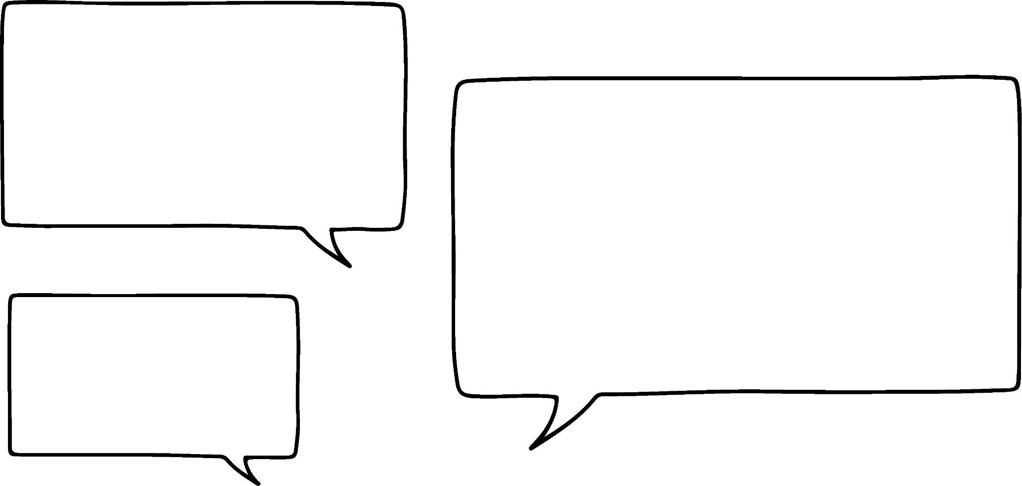
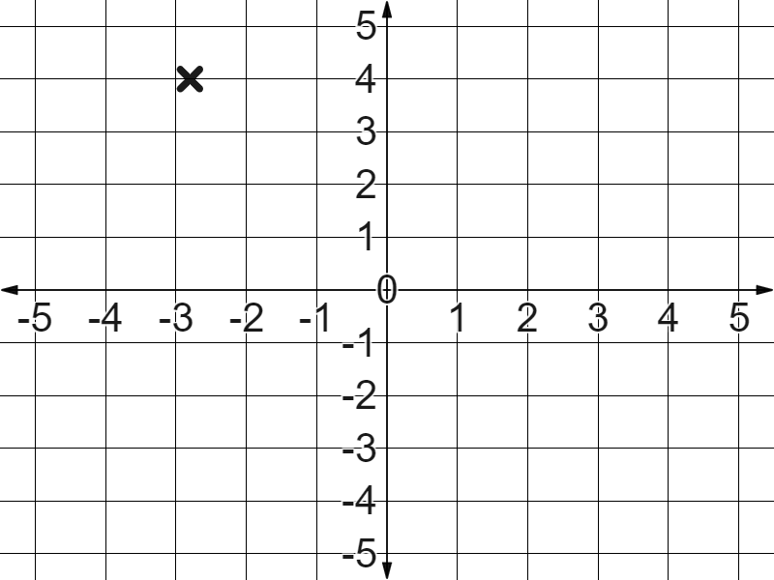

Plotting non-integer coordinates
Task A: Coordinates with non-integer values
1) Plot the following coordinates:
A (0.5,-2.5)
B
✖
B (-0.5,2.5)
C
(-2.25,
)
C
✖
D
D
✖
A
✖
2) Match the coordinates to the points on the graph:
A
✖
B
C
✖
✖
D
✖
A (1.8,2.2)
B (2.1,1.7)
C (-2.1,1.6)
D (-1.6,1.6)
E (1.6,-1.6)
✖
E
3) Jun says this.
The point is just past -3 so this is probably (-3.1,4)
Write a sentence justifying why Jun is wrong.
Your sentence might have included:
From the direction of the origin the coordinate is still approaching -3 so it is more likely to approximate as (-2.9,4).

Slide 2
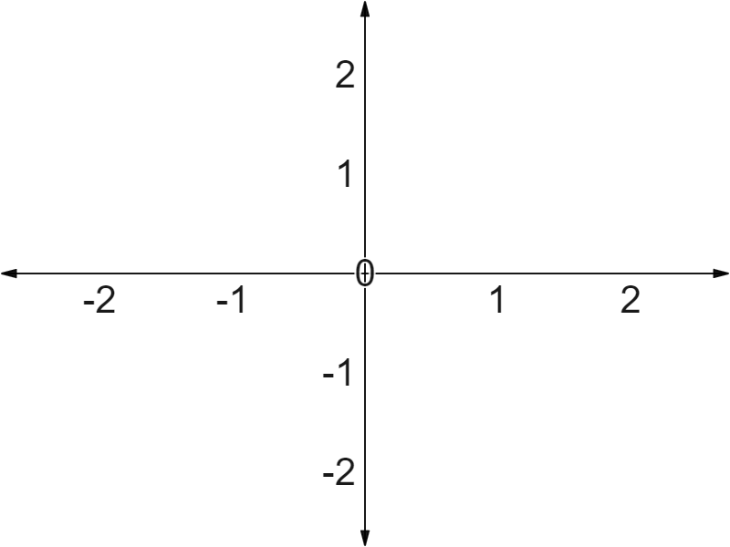
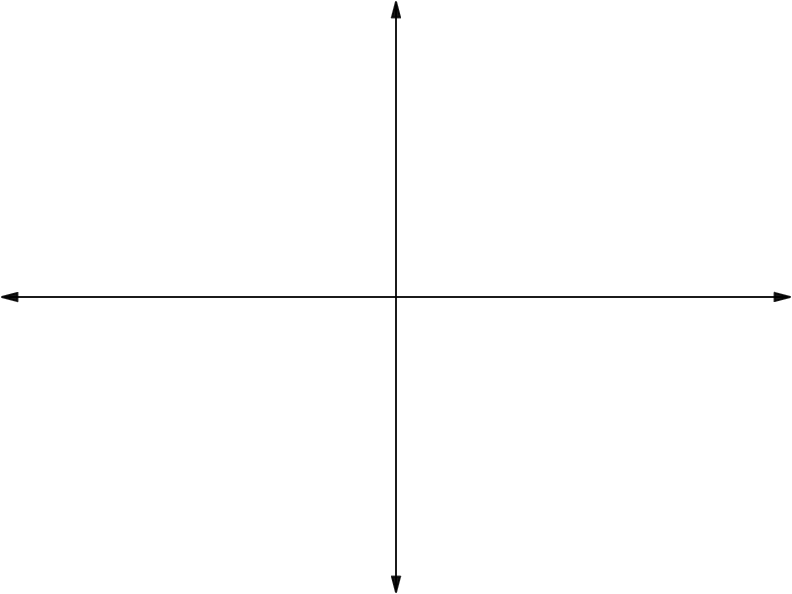
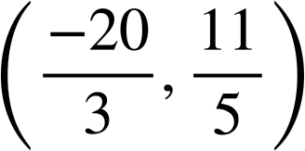
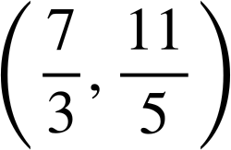
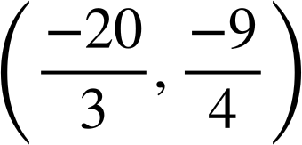
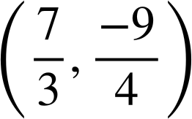
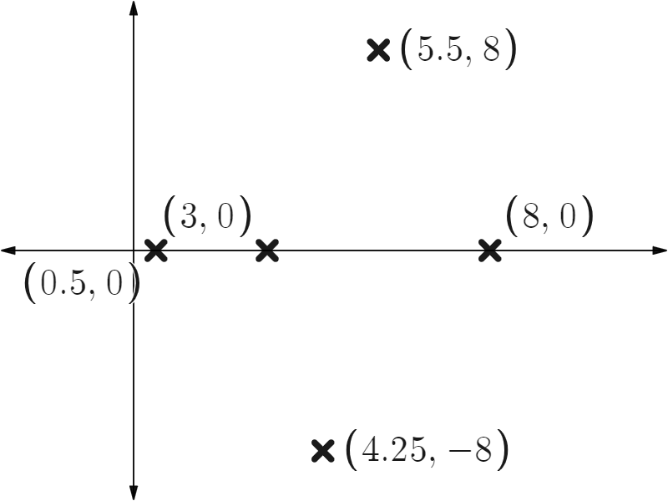
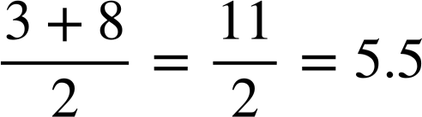
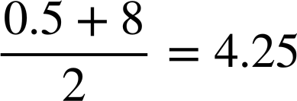
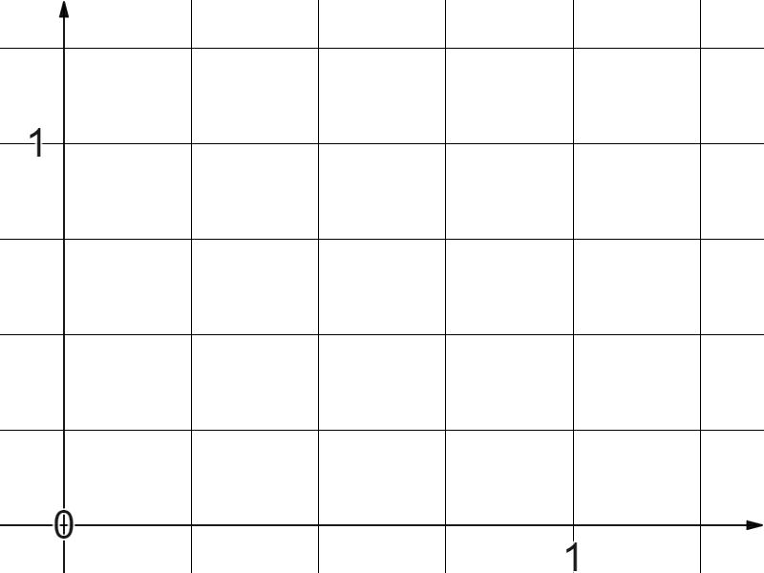

Plotting non-integer coordinates
Task B: Shapes with non-integer value coordinates
1) Find the missing coordinates of these rectangles.
(-1.1,0.9)
(0.4,0.9)
✖
✖
✖
✖
✖
✖
(-1.1,-2.3)
(0.4,-2.3)
✖
✖
2) Find the missing coordinate values in these isosceles triangles.
3) These four equally sized squares sit between the origin and coordinate (1,1)
Find coordinates A and B.
✖
(1,1)
✖
B
(0.75,0.75)
A
(0.25,0.5)
Coordinate A (0.25,0.5)
✖
Coordinate B (0.75,0.75)
✖
(0.25,0.25)
Mathematics in Education and Industry.
v2.2

